Slide 1

Sales Dash 1
File created on: 15-04-2025

Slide 2
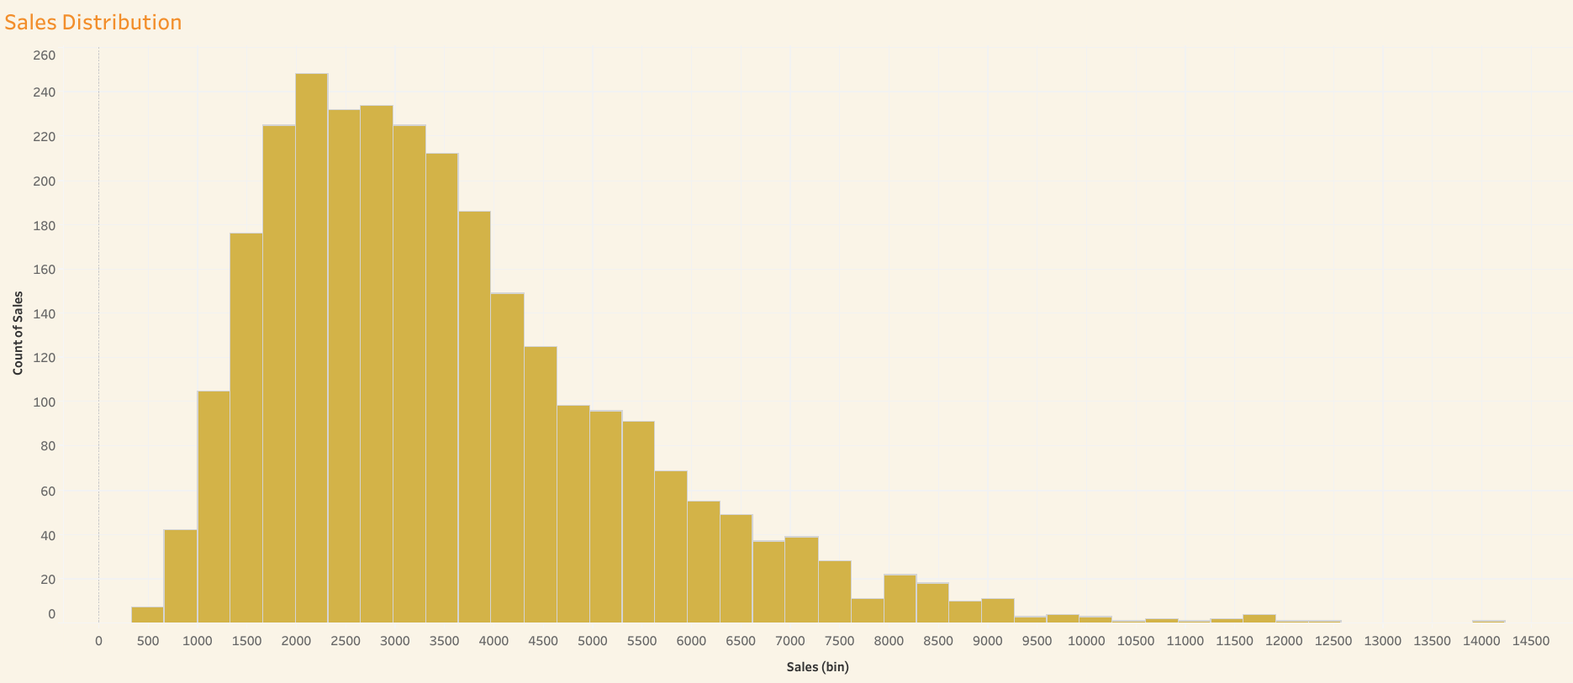

Slide 3
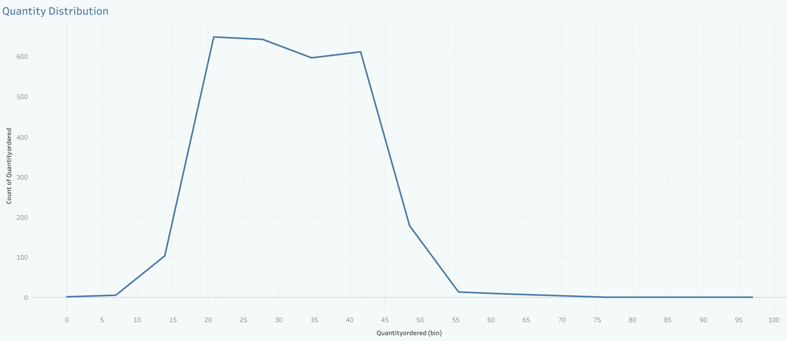

Slide 4
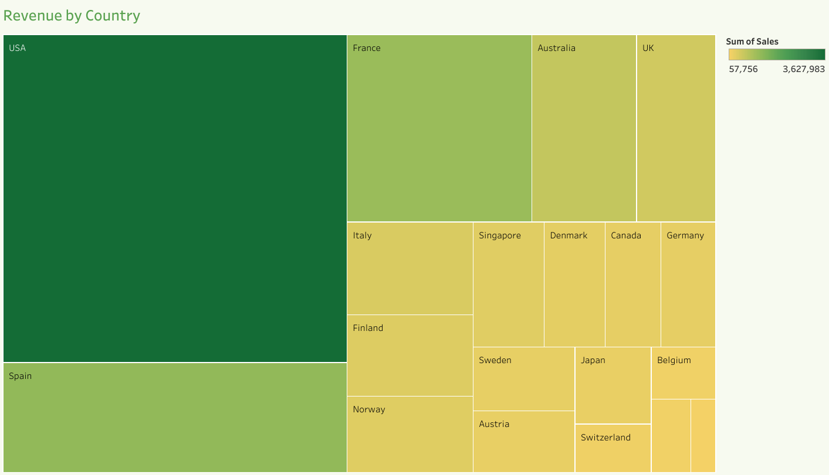

Slide 5
